Slide 1
Introduction to Data Visualization

Slide 2
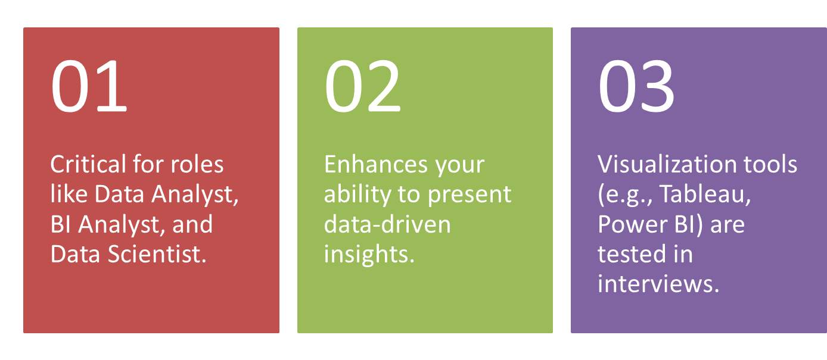
Why Visualization Skills Matter in Careers?

Slide 3
Learning Objectives
By the end of this session, you will be able to:
Understand the importance of data visualization.
Understand the various visualization techniques.
Learn how to create and interpret the various plots in Python.

Slide 4
Data Visualization in Decision-Making
Helps stakeholders understand trends and patterns quickly.
Increases the impact of presentations and reports.
Critical for strategy formulation and operational insights.

Slide 5
How does Data Visualization help?
Transforms raw data into clear, actionable insights.
Enhances decision-making by making patterns easier to detect.
Key for storytelling and communicating findings effectively.

Slide 6
Common Visualization Techniques
Line Charts: Best for tracking data over time (e.g., COVID cases).
Bar Charts: Effective for comparing categories.
Pie Charts: Visualizing part-to-whole relationships.
Scatter Plots: Showing relationships between variables.
Heat Maps: Visualizing density or intensity of data.

Slide 7
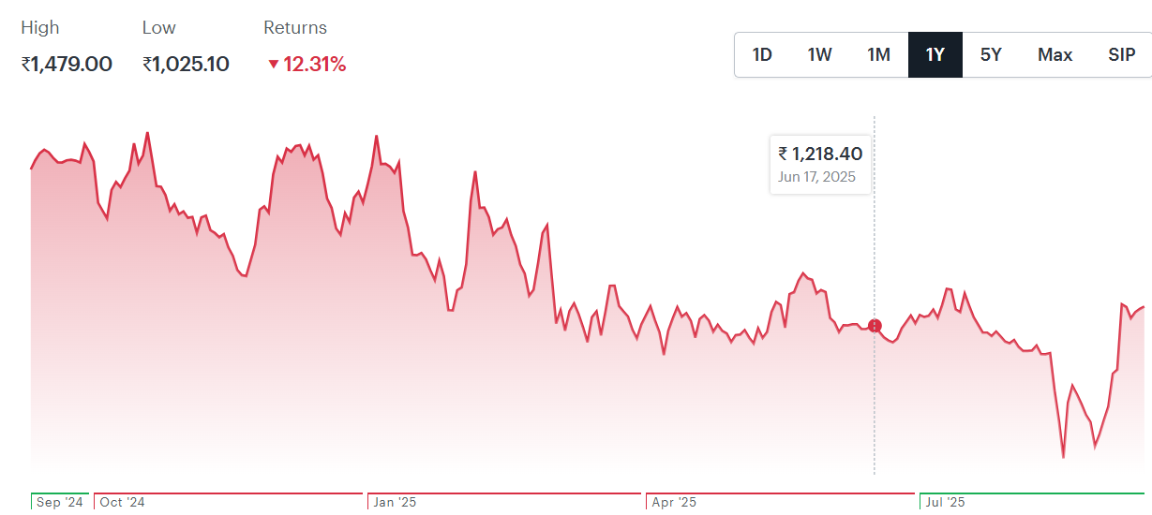
Line Chart Example: Stock Price of Bata India as on Sep 9

Slide 8
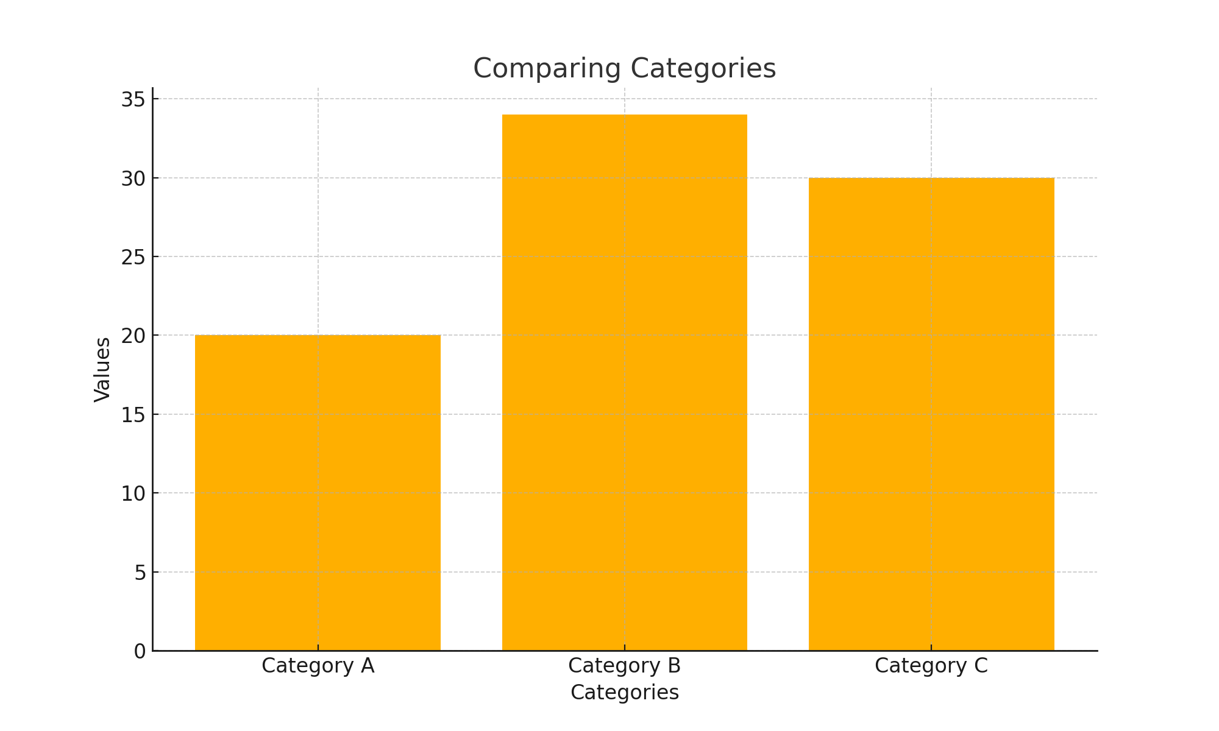
Bar Chart Example: Comparing Categories

Slide 9
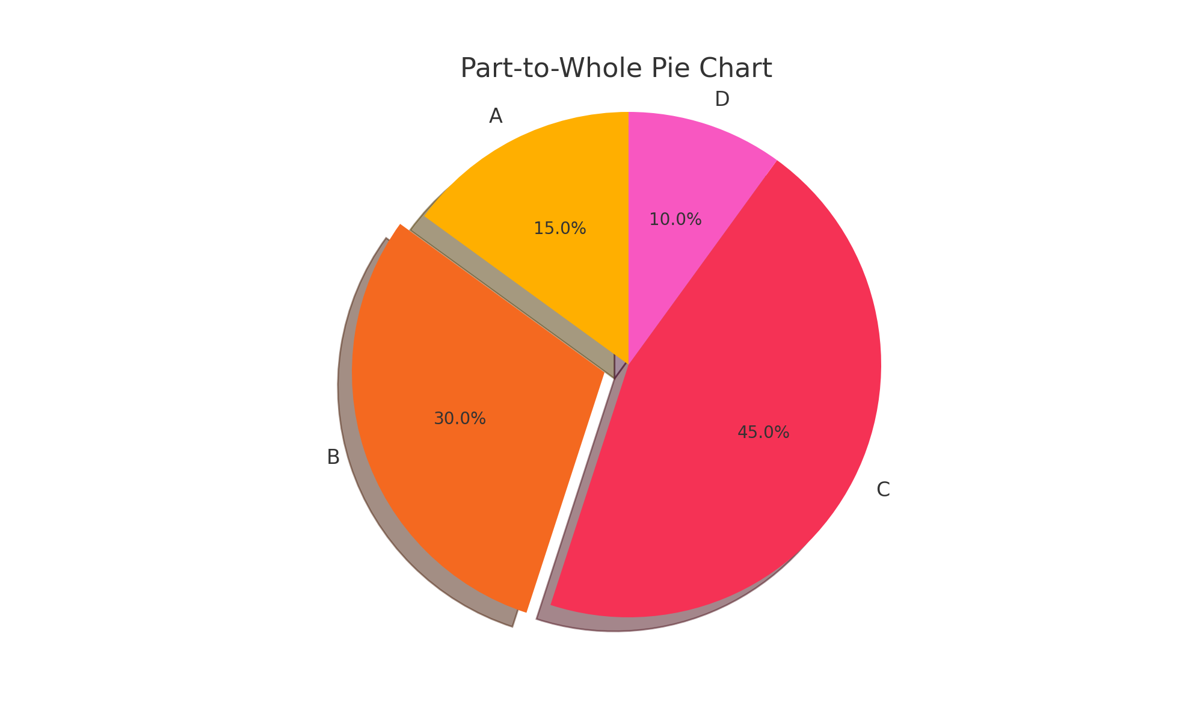
Pie Chart Example: Part-to-Whole

Slide 10
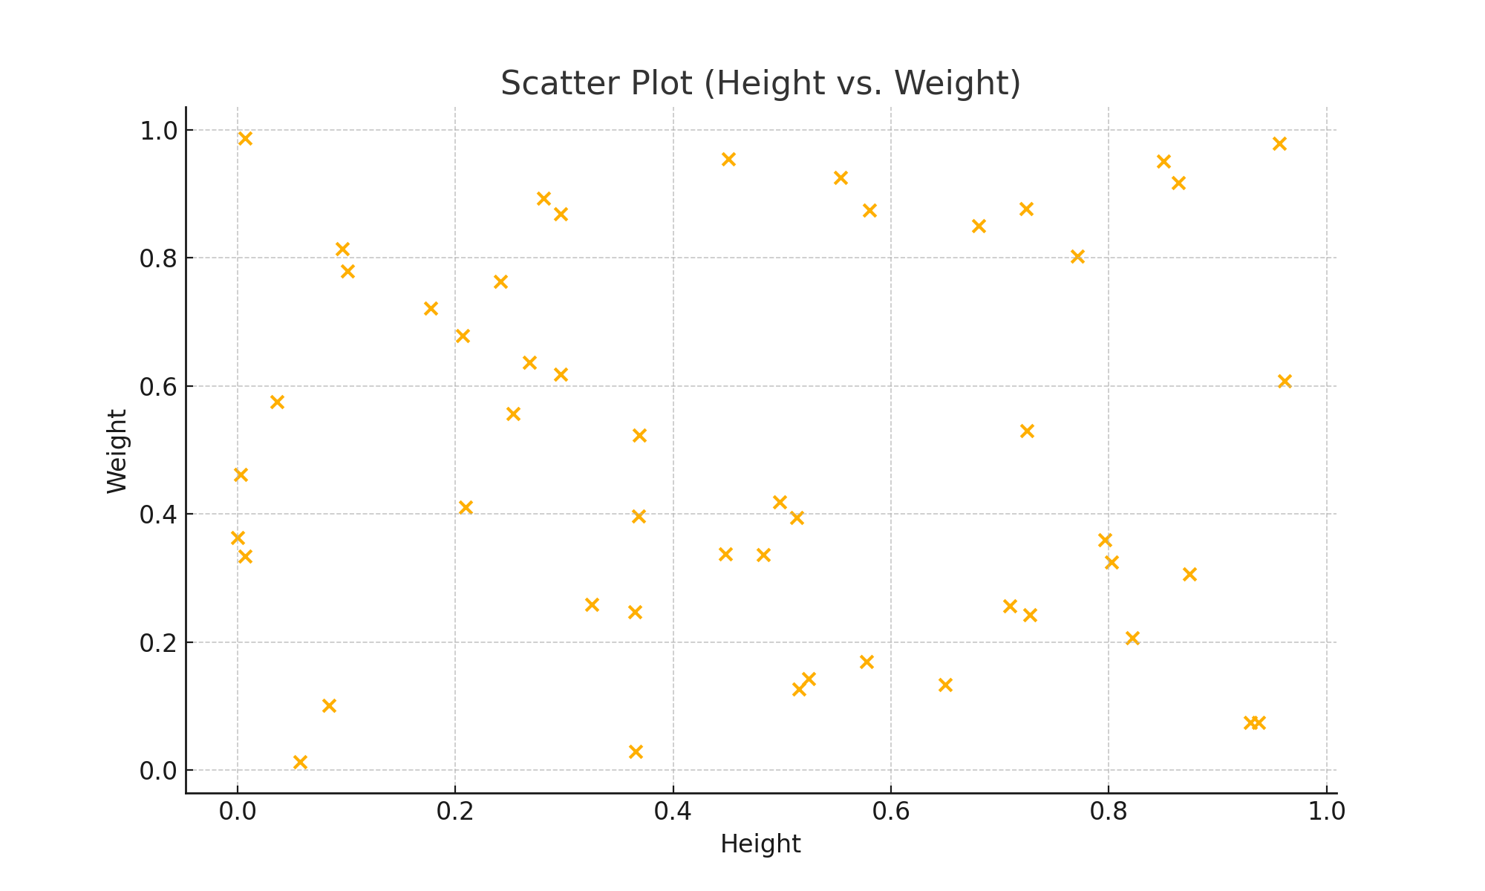
Scatter Plot Example: Height vs Weight

Slide 11
How to Choose the Right Visualization
Identify the type of data you are working with.
1
Understand the audience and the message you want to convey.
2
Choose charts that simplify complex data.
3
Avoid over-complicating with too many visual elements.
4

Slide 12
Multiple Choice Questions (MCQs)
1. A data scientist wants to show the monthly trend of website traffic over a year. Which visualization is most appropriate?
A. Scatter Plot
B. Line Chart
C. Pie Chart
D. Bar Plot
2. A researcher wants to examine the relationship between students’ study hours and their exam scores. Which visualization should be used?
A. Pie Chart
B. Line Chart
C. Scatter Plot
D. Bar Plot
Notes:
The most appropriate visualization to show the monthly trend of website traffic over a year is a Line Chart (Option B).
The most appropriate visualization to examine the relationship between students' study hours and their exam scores is a Scatter Plot (Option C).

Slide 13
Sample Questions
Sample Questions:
"How would you approach visualizing sales performance across regions?“
"Can you explain a time when a visualization led to actionable business insights?"
Hint: Practice explaining your thought process in both technical and business terms.

Slide 14
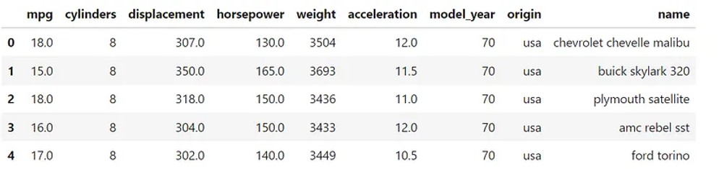
Python Implementation
‘mpg’ dataset in seaborn
You are a data scientist working at car sales outlet and you have been asked to perform EDA using visualization on the data….

Slide 15
Session Summary
In this session, we have discussed about:
The importance of visualization from career as well as business perspectives.
The various visualization techniques and when to us each one of these.
How to create and interpret the various plots in Python.

Slide 16
Reference Links
How to Create Stunning Data Visualizations in Python: Top 10 Techniques to Learn
Mastering Credit Risk Analysis: A Step-by-Step Guide to Descriptive Statistics in Python
How Much Statistics Do You Really Need for Data Science?
Phases of data science and analytics.

